Slide 1
OCTAL NUMBERs
Octal to decimal conversion
Decimal to octal conversion
Octal to binary conversion
Binary to octal conversion

Slide 2

Octal to decimal conversion

Slide 3
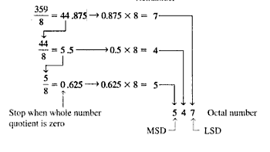

Decimal to octal conversion

Slide 4

Octal to binary conversion

Slide 5


Slide 6
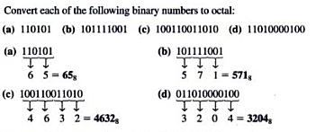

Slide 7
Binary Coded Decimal (BCD)
Decimal and BCD digits

Slide 8
Convert decimal to BCD number
Convert BCD to Decimal
BCD Addition

Slide 9
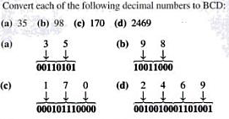

Slide 10
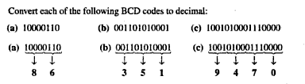

Slide 11

BCD Addition

Slide 12
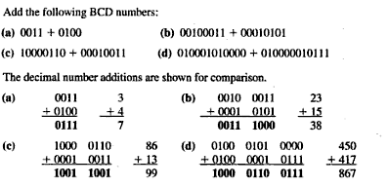

Slide 13
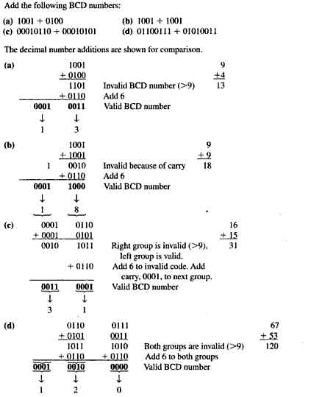

Slide 14
Gray codes
Gray Code
.
The Gray code is unweighted and is not an arithmetic code that is, there are no specific weight assigned to the bit position. The important feature of the Gray code is that it exhibits only a single bit change from one code word to the next in sequence

Slide 15
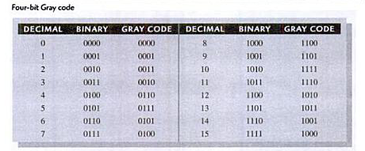

Slide 16


Binary to Gray code

Slide 17


Gray code to Binary

Slide 18

problem

Slide 19
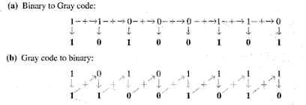
solution

